Slide 1
Timestamp Temporal Logic (TTL) for Testing the Timing of Cyber-Physical Systems
EMSoft 2017
MOHAMMADREZA MEHRABIAN, MOHAMMAD KHAYATIAN, AVIRAL SHRIVASTAVA, Arizona State University
JOHN C. EIDSON, University of California Berkeley
PATRICIA DERLER, HUGO A. ANDRADE, National Instruments
YA-SHIAN LI-BABOUD, EDWARD GRIFFOR, National Institute of Standard and Technology (NIST)
MARC WEISS, Marc Weiss Consulting
KEVIN STANTON, Intel corporation

Slide 2
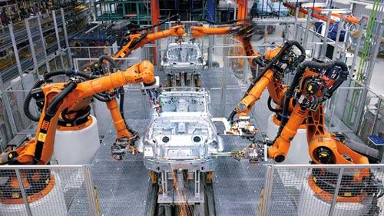
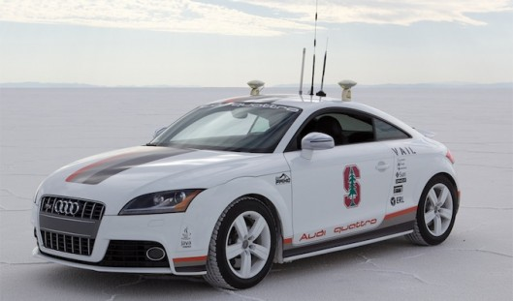
CPS: Exciting times
Sensors → sensor networks
Embedded systems → networked embedded systems
Control has come to software
Mechanical → Electrical → computer
The real question for our times is:
If I can sense anything, and I can control everything, what (good) can I do?
Nexus of CPS, Machine Learning and Big Data
Enable large scale and compelling applications
Autonomous cars, Smart cities, City-level traffic management, Smart grid

Slide 3
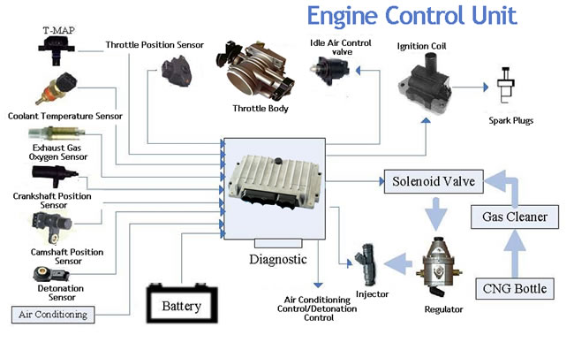

Timing is fundamental to CPS
Tight sense-compute-actuation loop
Hard-real-time CPS
correctness depends on functionality as well as correct timing
autonomous cars
Safety-critical CPS
failure of timing can lead to a catastrophe or even a disaster!!
Timing constraints come from
System stability requirements
System performance requirements
Legal requirements

Slide 4
But how can we specify timing constraints?
LTL (Linear Temporal Logic)
Deals with discrete sequence of states
Based on logic operators (¬, ∧, ∨), and temporal operators, next (N), always (G), eventually (F), and until (U).
Boolean predicates, discrete time
Example constraint: G (r => F g)
Not sufficient for CPS – CPS operate in continuous time.
MTL (Metric Temporal Logic)
Boolean predicates, real-time
Example constraint: G (r => F_{[0,5]} g)
Not sufficient for CPS – CPS may have real-valued logic

Slide 5
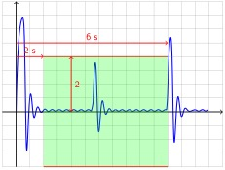
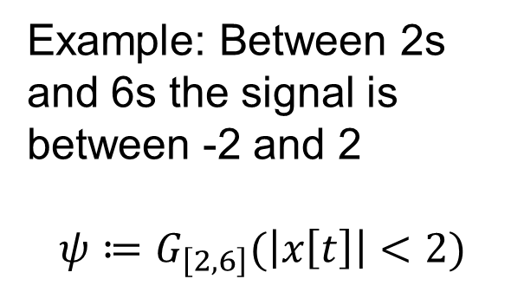
STL – Signal Temporal Logic
Predicates over real value, real-time
Assume signals x₁[t], x₂[t], ..., x_{n}[t], then atomic predicates are of the form: μ = f(x₁[t],...,x_{n}[t]) > 0
Example: Between 2s and 6s the signal is between -2 and 2
$$ψ≔G_{\left[2,6\right]}(\left|x\left[t\right]\right|<2)$$

Slide 6




Express timing constraints in STL
Intuitive to specify value-based (level-based) timing constraints
Example: the value of x[t] is less than 2
φ := G_{[2,6]} (|x[t]| < 2)
Hard to express event-based (edge-based) timing constraints
Example: Whenever signal x₁ rises above 0.5, signal x₂ should rise above 0.6 within 1 second
□ (↑(x₁>0.5) ⇒ (♢_{[0,1]}(↑(x₂>0.6))))
□ : Globally, ♢: Eventually, ↑: Rise operator
Definition of the rise operator
↑ψ = (ψ ∧(¬ψS⊤)) ∨ (¬ψ ∧(ψU⊤))
voltage
$$x_{1}$$
$$0.5v$$
$$⊤$$
$$⊥$$
event
time

Slide 7
Express timing constraints in STL
Harder to express sequential timing constraints on events – they become nested constraints
Example: Whenever signal x₁ rises above 0.5, signal x₂ should rise above 0.6 within 1 second and after that, signal x₃ should fall below 0.4 within 5 seconds
ψ = □ ((↑(x₁>0.5)) ⇒ (♢_{[0,1]}(↑(x₂>0.6)) => (♢_{[0,5]} (↓(x₃>0.4)))))
□ : Globally, ♢: Eventually, ↑: Rise operator, ↓: fall operator
↑ψ = (ψ ∧(¬ψS⊤)) ∨ (¬ψ ∧(ψU⊤))
↓ψ = (¬ψ ∧(ψS⊤)) ∨ (ψ ∧(¬ψU⊤))
ψ = □((x₁> 0.5) ∧ (¬(x₁ > 0.5)S⊤)) ∨ (¬(x₁ > 0.5) ∧ ((x₁ > 0.5)U⊤))) ⇒ (♢_{[0,1]}((x₂ > 0.6) ∧ (¬(x₂ > 0.6)S⊤)) ∨ (¬(x₂ > 0.6) ∧ ((x₂ > 0.6)U⊤)) ⇒ (♢_{[0,5]}((¬(x₃ > 0.4) ∧ ((x₃ > 0.4)S⊤))) ∨ (((x₃ > 0.4) ∧ (¬(x₃ > 0.4)U⊤))))))

Slide 8
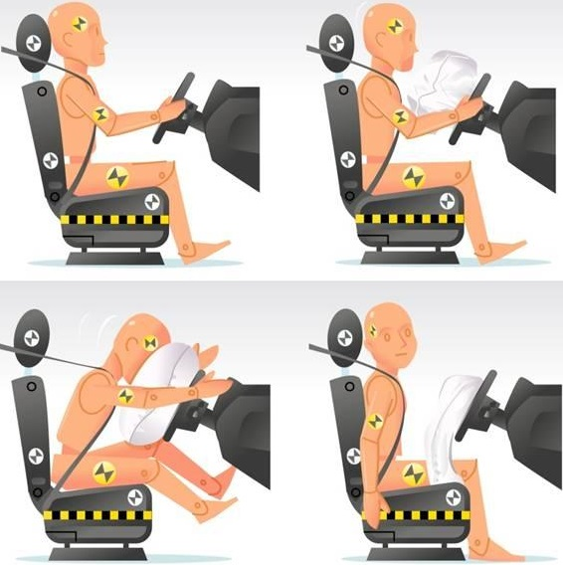
Expressing timing constraints in STL
Expressing the acceptable tolerance of the timing constraints will make the constraint expressions even more complicated
Signals x₁ and x₂ should rise above 0.5 within 1 millisecond of each other
Event-based timing constraints are quite common in CPS
Example: Airbag and seatbelt operation during an accident in cars
After a collision is detected, the seat belt should tighten after at most 20 ms, and simultaneously the airbag must deploy, and then after at most 20 ms, the seat belt should be loosened.
Time | Event
t | Accident
t + 20 ±1ms | Seat belt tighten + airbag deploy
t + 40 ±1ms | Seatbelt loosen

Slide 9
Timestamp Temporal Logic (TTL)
Simply and intuitively express the event-based timing constraints of distributed CPS
Easier to specify the acceptable tolerance of the timing constraints
Tolerance of timing and its testing is fundamental to CPS and timing measurement
There is no perfect measurement system
Systematic methodology to generate the logic for real-time monitoring of the TTL timing constraints

Slide 10





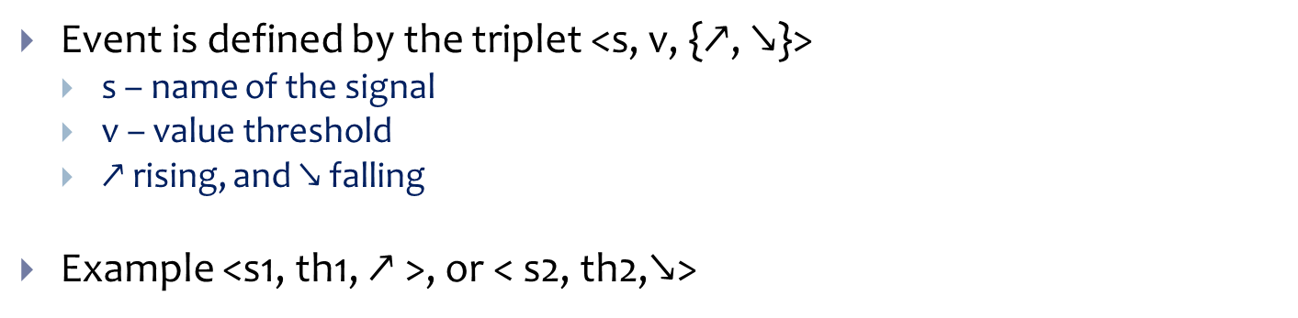






Event Definition
Event is defined by the triplet <s, v, {$\text{↗}$, $\text{↘}$}>
s – name of the signal
v – value threshold
$\text{↗}$rising, and $\text{↘}$falling
Example <s1, th1, $\text{↗}$>, or < s2, th2,$\text{↘}$>
Voltage
$$s_{1}$$
$$th_{1}$$
$$th_{2}$$
$$s_{2}$$
$$s_{1}>th_{1}$$
$$s_{2}<th_{2}$$
$$⋈(s_{1}>th_{1})$$
$$⋈(s_{2}<th_{2})$$
$$t_{1}$$
$$t_{2}$$
$$t_{3}$$
time

Slide 11




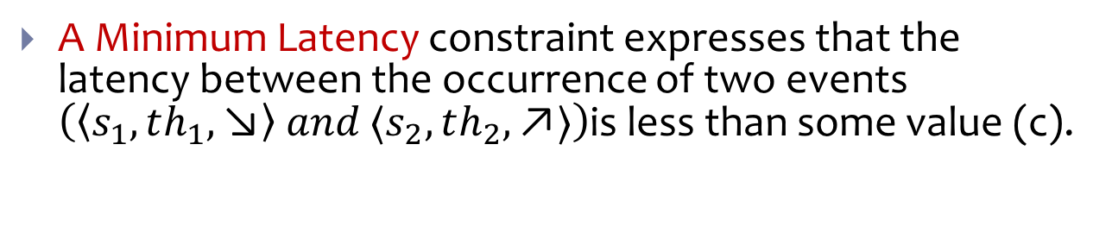




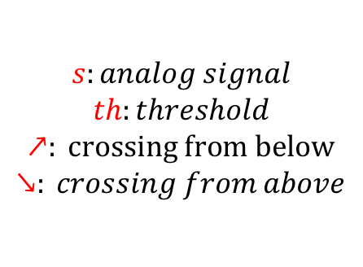

Minimum Latency Constraint
A Minimum Latency constraint expresses that the latency between the occurrence of two events $\left(〈s_{1},th_{1},\text{↘}〉 and 〈s_{2},th_{2},\text{↗}〉\right)$is less than some value (c).
$ℒ\left(〈s_{1},th_{1},\text{↘}〉,〈s_{2},th_{2},\text{↗}〉\right)$ < c
$$voltage$$
$$th_{1}$$
$$s_{1}$$
$$s_{2}$$
$$th_{2}$$
$$s:analog signal$$
$$th:threshold$$
$$↗: crossing from below$$
$$↘: crossing from above$$
$$time$$
$$Δt$$
$$Δt<c$$

Slide 12


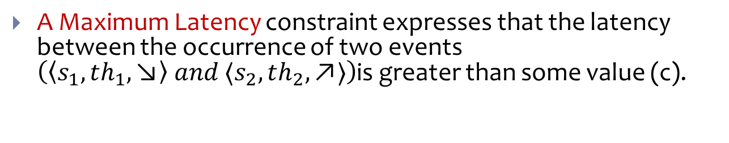
Maximum Latency Constraint
A Maximum Latency constraint expresses that the latency between the occurrence of two events $\left(〈s_{1},th_{1},\text{↘}〉 and 〈s_{2},th_{2},\text{↗}〉\right)$is greater than some value (c).
$ℒ\left(〈s_{1},th_{1},\text{↘}〉,〈s_{2},th_{2},\text{↗}〉\right)$ > c
$$voltage$$
$$th_{1}$$
$$s_{1}$$
$$s_{2}$$
$$th_{2}$$
$$s:analog signal$$
$$th:threshold$$
$$↗: crossing from below$$
$$↘: crossing from above$$
$$time$$
$$Δt$$
$$Δt>c$$

Slide 13


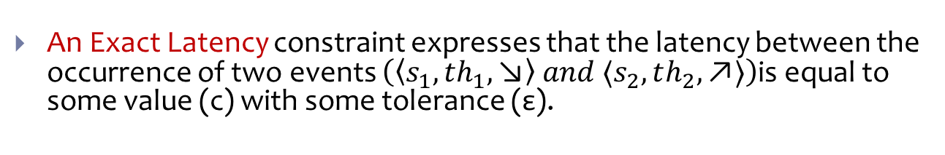
Exact Latency Constraint
An Exact Latency constraint expresses that the latency between the occurrence of two events $\left(〈s_{1},th_{1},\text{↘}〉 and 〈s_{2},th_{2},\text{↗}〉\right)$is equal to some value (c) with some tolerance (ε).
$ℒ\left(〈s_{1},th_{1},\text{↘}〉,〈s_{2},th_{2},\text{↗}〉\right)$ = c ± ε
$$voltage$$
$$th_{1}$$
$$s_{1}$$
$$s_{2}$$
$$th_{2}$$
$$s:analog signal$$
$$th:threshold$$
$$↗: crossing from below$$
$$↘: crossing from above$$
$$time$$
$$Δt$$
$$c\text{−}\text{ε}<Δt<c\text{+}\text{ε}$$

Slide 14

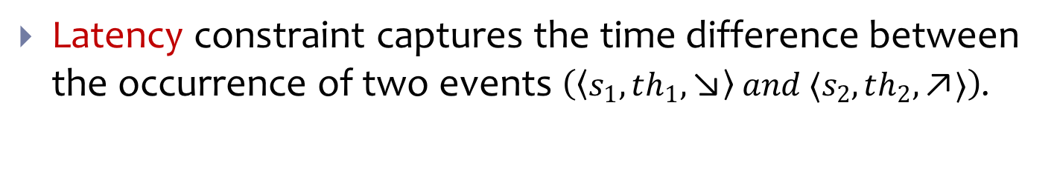
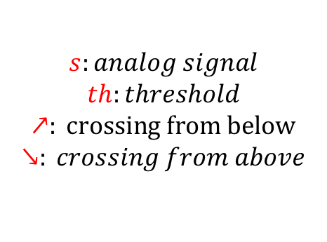

Latency Constraint
Latency constraint captures the time difference between the occurrence of two events $\left(〈s_{1},th_{1},\text{↘}〉 and 〈s_{2},th_{2},\text{↗}〉\right)$.
$$voltage$$
$$th_{1}$$
<
>
=
$$s_{1}$$
$$ℒ\left(〈s_{1},th_{1},\text{↘}〉,〈s_{2},th_{2},\text{↗}〉\right)$$
$$c±ε$$
$$s_{2}$$
$$th_{2}$$
$$s:analog signal$$
$$th:threshold$$
$$↗: crossing from below$$
$$↘: crossing from above$$
$$time$$
$$Δt$$

Slide 15



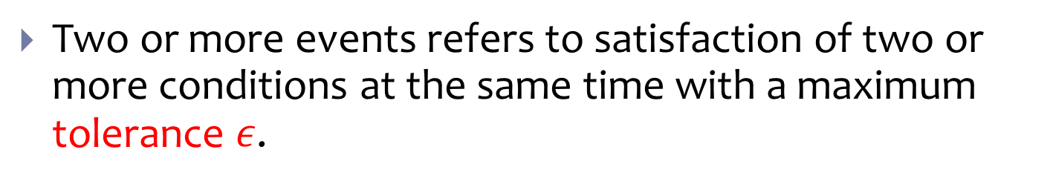




Simultaneity Constraint
Two or more events refers to satisfaction of two or more conditions at the same time with a maximum tolerance $ε$.
$$𝒮\left(〈s_{1},th_{1},\text{↗}〉,〈s_{2},th_{2},\text{↘}〉,〈s_{3},th_{3},\text{↗}〉,ε\right)$$
$$th_{1}$$
$$s_{1}$$
$$th_{2}$$
$$s_{2}$$
$$th_{3}$$
$$s_{3}$$
$$ε$$
time

Slide 16
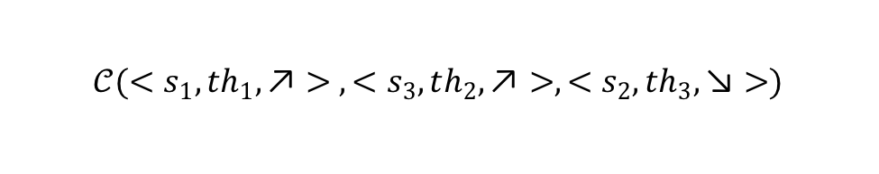






Chronological Constraint
Chronological constraint is specified when the occurrence order of events matters.
$$𝒞(<s_{1},th_{1},\text{↗}> ,<s_{3},th_{2},\text{↗}>,<s_{2},th_{3},\text{↘}>)$$
$$th_{1}$$
$$th_{2}$$
$$s_{1}$$
$$s_{2}$$
$$th_{3}$$
$$s_{3}$$
time

Slide 17




Frequency Constraint
Frequency constraint captures the time interval between every two consecutive events of a repetitive signal.
$$F\left(〈 s,th,\text{↗}〉\right)=\frac{1}{T±ε}$$
Voltage
$$th$$
$$s$$
$$T±ε$$
time

Slide 18
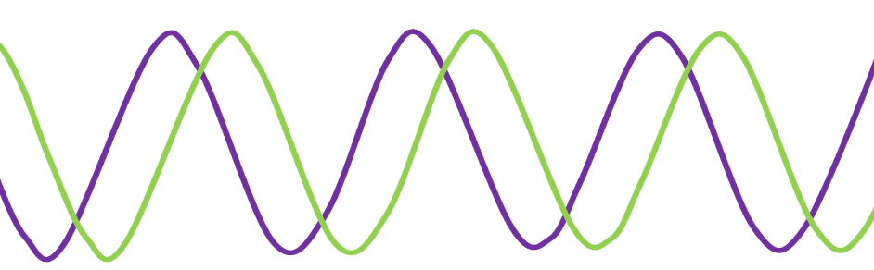











Phase Constraint
Phase constraint captures the latency between two repetitive signal events that have the same frequency
$$F\left(〈 s_{1},th_{1},\text{↗}〉\right)=\frac{1}{\begin{aligned}T_{1}±ε1\end{aligned}}$$
$$F\left(〈s_{2},th_{2},\text{↗}〉\right)=\frac{1}{T_{1}±ε1}$$
$$P\left(〈s_{1},th_{1},\text{↗}〉,〈s_{2},th_{2},\text{↗}〉\right)=c±ε2$$
Voltage
$$T_{1}±ε1$$
$${th}_{1}$$
$$s_{2}$$
$$th_{2}$$
$$s_{1}$$
$$Δt$$
$$T_{1}±ε1$$
time
$$Δt= c±ε2$$

Slide 19



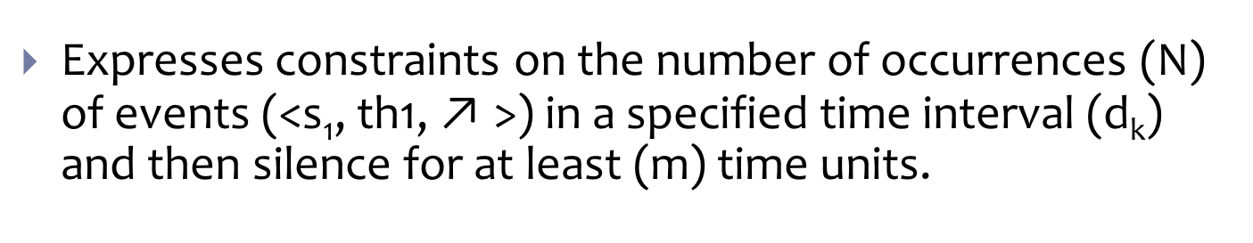



Burst Constraint
Expresses constraints on the number of occurrences (N) of events (<s₁, th1, $\text{↗}$>) in a specified time interval (d_{k}) and then silence for at least (m) time units.
$$B\left(〈s_{1},th_{1},\text{↗}〉,N,d_{k},m\right)$$
Voltage
$$N$$
$$th_{1}$$
$$s_{1}$$
…
$$d_{k}$$
time
$$m$$

Slide 20
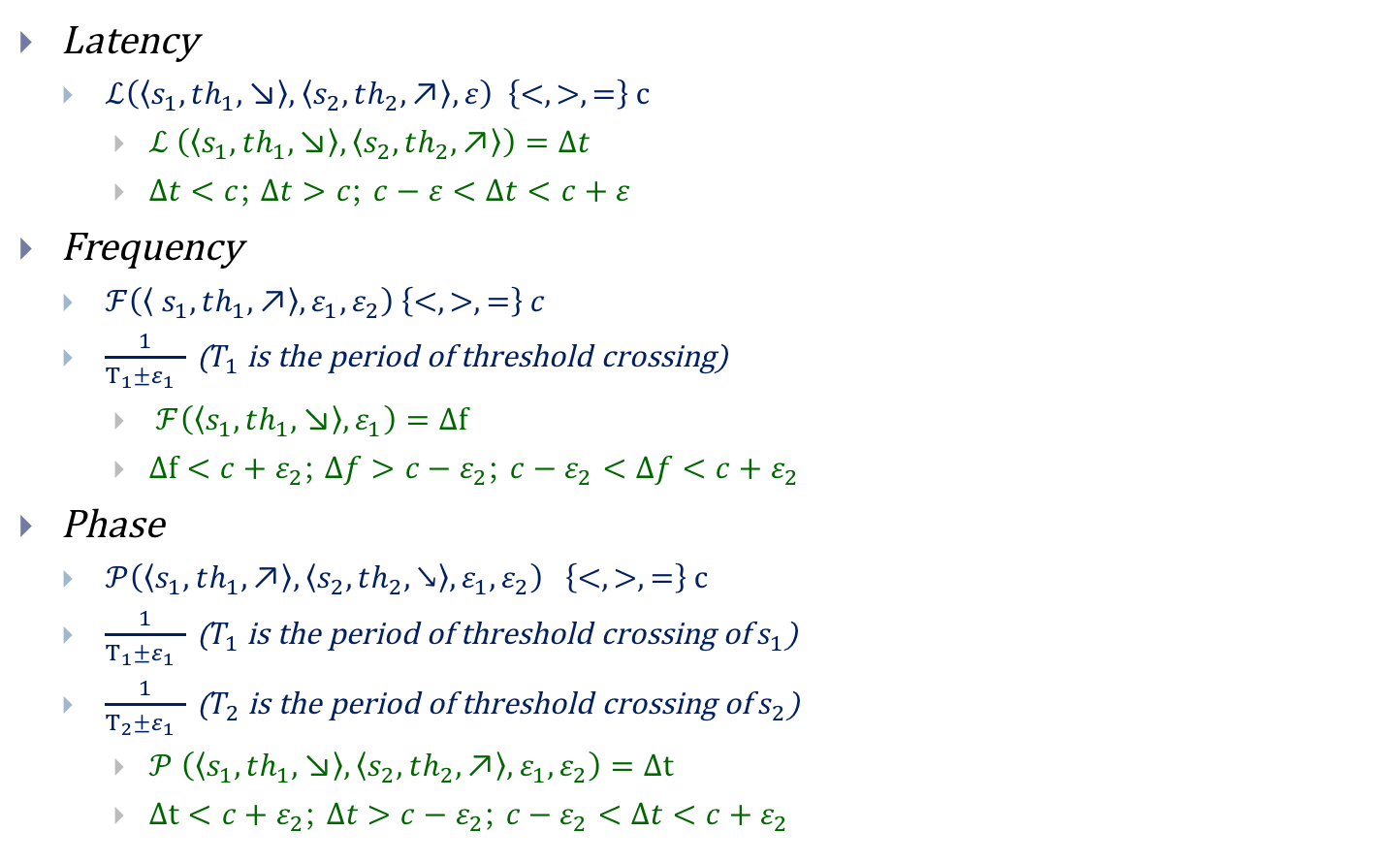
TTL Syntax
Latency
$ℒ\left(〈s_{1},th_{1},\text{↘}〉,〈s_{2},th_{2},\text{↗}〉,ε\right) \left\{<, >, =\right\} c$
$ℒ \left(〈s_{1},th_{1},\text{↘}〉,〈s_{2},th_{2},\text{↗}〉\right)=Δt$
$Δt<c$; $Δt>c$; $c−ε<Δt<c+ε$
Frequency
$ℱ\left(〈 s_{1},th_{1},\text{↗}〉,ε_{1},ε_{2}\right) \left\{<, >, =\right\} c$
$\frac{1}{T_{1}±ε_{1} }$ ($T_{1}$ is the period of threshold crossing)
$ℱ\left(〈s_{1},th_{1},\text{↘}〉,ε_{1}\right)=Δf$
$Δf<c+ε_{2}$; $Δf>c−ε_{2}$; $c−ε_{2}<Δf<c+ε_{2}$
Phase
$𝒫\left(〈s_{1},th_{1},\text{↗}〉,〈s_{2},th_{2},↘〉,ε_{1},ε_{2}\right) \left\{<, >, =\right\} c$
$\frac{1}{T_{1}±ε_{1} }$ ($T_{1}$ is the period of threshold crossing of $s_{1}$)
$\frac{1}{T_{2}±ε_{1} }$ ($T_{2}$ is the period of threshold crossing of $s_{2}$)
$𝒫 \left(〈s_{1},th_{1},\text{↘}〉,〈s_{2},th_{2},\text{↗}〉,ε_{1},ε_{2}\right)=Δt$
$Δt<c+ε_{2}\text{; }Δt>c−ε_{2}\text{; }c−ε_{2}<Δt<c+ε_{2}$

Slide 21
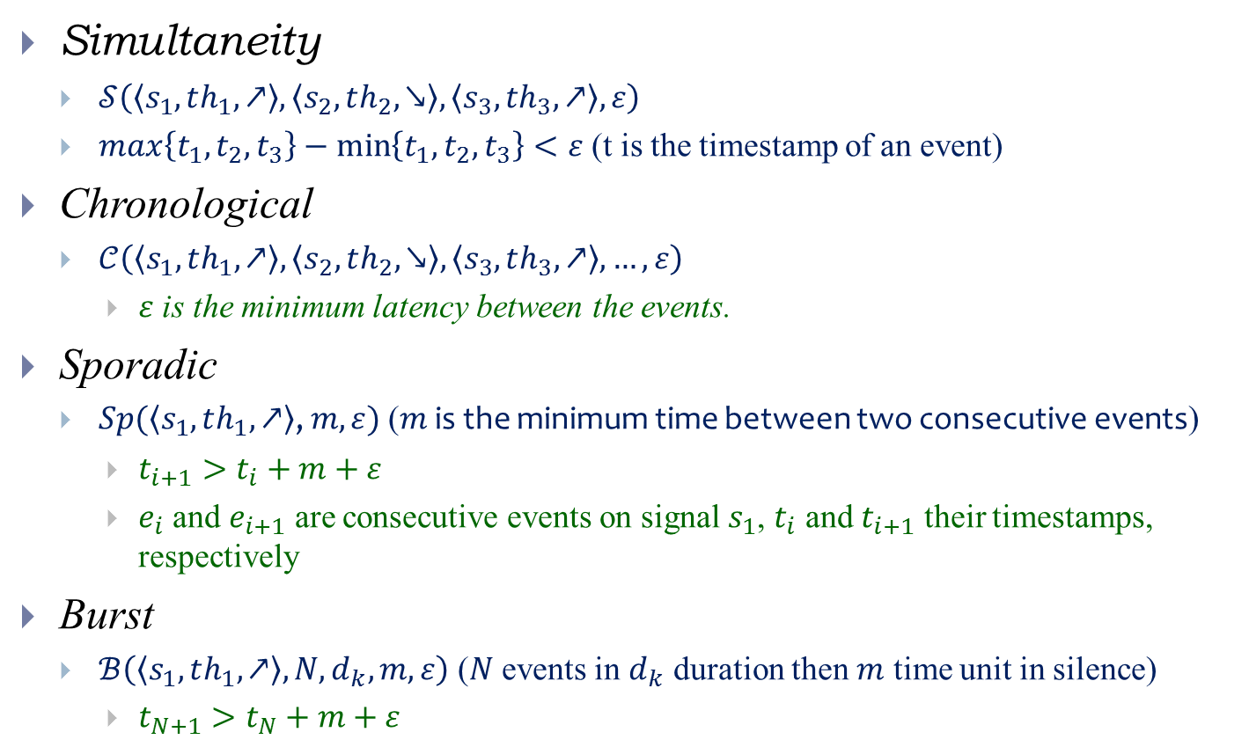
TTL Syntax
Simultaneity
$𝒮\left(〈s_{1},th_{1},\text{↗}〉,〈s_{2},th_{2},\text{↘}〉,〈s_{3},th_{3},\text{↗}〉,ε\right)$
$max\left\{t_{1},t_{2},t_{3}\right\}−\min\left\{t_{1},t_{2},t_{3}\right\}<ε$ (t is the timestamp of an event)
Chronological
$𝒞\left(〈s_{1},th_{1},\text{↗}〉,〈s_{2},th_{2},\text{↘}〉,〈s_{3},th_{3},\text{↗}〉,…,ε\right)$
$ε$ is the minimum latency between the events.
Sporadic
$Sp(〈s_{1},th_{1},\text{↗}〉\text{,} m,ε)$ ($m$ is the minimum time between two consecutive events)
$t_{i+1}>t_{i}+m+ε$
$e_{i}$ and $e_{i+1}$ are consecutive events on signal $s_{1}$, $t_{i}$ and $t_{i+1}$ their timestamps, respectively
Burst
$ℬ\left(〈s_{1},th_{1},\text{↗}〉,N,d_{k},m,ε\right)$ ($N$ events in $d_{k}$ duration then $m$ time unit in silence)
$t_{N+1}>t_{N}+m+ε$

Slide 22
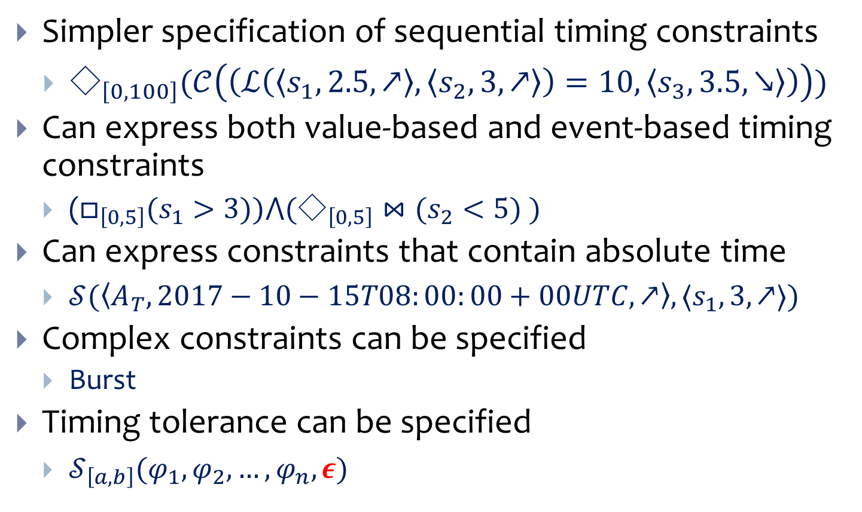
TTL Capabilities
Simpler specification of sequential timing constraints
$◇_{\left[0,100\right]}(𝒞\left(\left(ℒ\left(〈s_{1},2.5,↗〉,〈s_{2},3,↗〉\right)=10,〈s_{3},3.5,↘〉\right)\right))$
Can express both value-based and event-based timing constraints
($□_{\left[0,5\right]}(s_{1}>3))⋀(◇_{\left[0,5\right]}⋈(s_{2}<5) )$
Can express constraints that contain absolute time
$𝒮(〈A_{T}, 2017−10−15T08:00:00+00UTC,↗〉,〈s_{1},3,↗〉)$
Complex constraints can be specified
Burst
Timing tolerance can be specified
$𝒮_{\left[a,b\right]}(φ_{1},φ_{2},…, φ_{n},ε)$

Slide 23







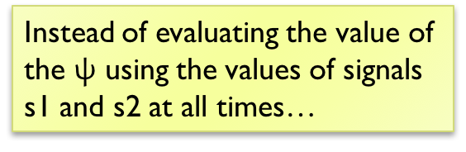







Latency Constraint Monitoring
$$voltage$$
$$3v$$
$$\text{ψ} \text{=}(L\left(\left\langle s_{1},3,\text{↘}\right\rangle ,\left\langle s_{2},1,\text{↗}\right\rangle \right)>2)$$
$$s_{1}$$
Instead of evaluating the value of the $\text{ψ}$ using the values of signals s1 and s2 at all times…
$$s_{2}$$
$$1v$$
$$time$$
.. a timestamp based approach allows us to evaluate the constraint only when there is an event (defined in the constraint) on s₁ or s₂.
$$Δt$$
$$Δt$$
$$2$$
NaN
$$1$$
More efficient testing logic
$$⊤$$
$$⊥$$

Slide 24




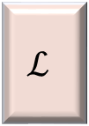
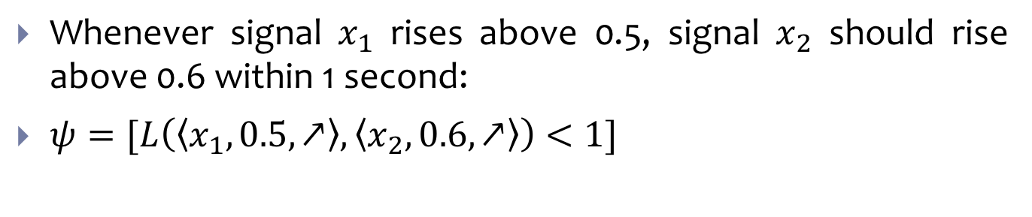

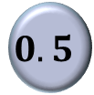








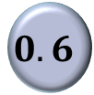

Generate Logic to Monitor TTL Constraints
Whenever signal $x_{1}$ rises above 0.5, signal $x_{2}$ should rise above 0.6 within 1 second:
$ψ=[L\left(〈x_{1},0.5,↗〉,〈x_{2},0.6,↗〉\right)<1]$
$$<$$
$$x_{1}$$
$$ℒ$$
>
$$⋈$$
$$1$$
$$0.5$$
$$ℒ$$
$$⋈$$
$$⋈$$
$$x_{2}$$
<
>
$$⋈$$
$$1$$
$$0.6$$
>
>
$$x_{1}$$
$$0.5$$
$$x_{2}$$
$$0.6$$

Slide 25
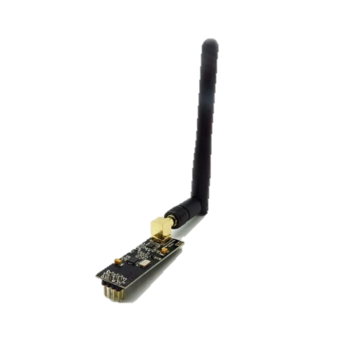
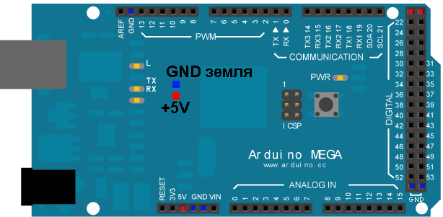
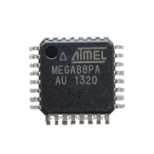
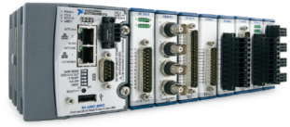
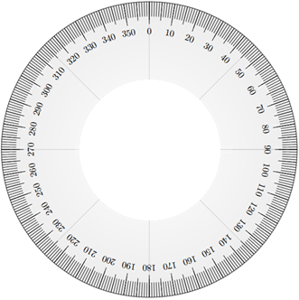



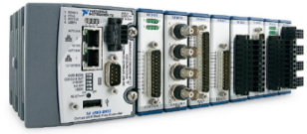



Case Study: Two Synchronized Motors
CPS
Master Controller
Slave Controller
Synchronized
by NTP
Testbed
c-Rio Testbed part1
$$S_{1}$$
$$S_{2}$$
Optical sensor1
Synchronized
by IEEE-1588
Optical sensor2
c-Rio Testbed part2
DC Motor2
DC Motor1
$$\left(\left(ℱ\left(〈S_{1},2.5,V ↗〉\right)==60±1Hz\right)\left(F \left(〈 S_{2}, 2.5V ,↗〉\right)==60±1 Hz\right)\right)$$
$$^((P(〈S_{1},2.5V ,↗〉,〈S_{2},2. 5V, ↗〉) ) < 4 ms)$$

Slide 26















Two Synchronized Motors in TTL
$$s_{1}$$
>
$$⋈$$
$$ℱ$$
==
$$2.5$$
$$60$$
$$s_{2}$$
>
$$⋈$$
$$ℱ$$
==
$$YES/NO$$
$$2.5$$
$$60$$
$$s_{1}$$
>
$$⋈$$
$$𝒫$$
<
$$2.5$$
$$4ms$$
$$s_{2}$$
>
$$⋈$$
$$2.5$$

Slide 27
Conclusion
Timing is fundamental to CPS
How to specify timing constraints
LTL, and MTL do not allow for real-valued signals, and expressing event-based timing constraints is hard in STL
Timestamp Temporal Logic (TTL)
Latency, frequency, phase, simultaneity, chronological, sporadic and burst timing constraints
Allows for simpler expression of event-based timing constraints, and sequential timing constraints
Allows for mixed value-based and event-based timing constraints
Allows for global time in the timing constraints
Timing tolerances can also be specified.
Systematic methodology to generate the logic for monitoring the TTL timing constraints
Demonstrated on synchronized motors, and simultaneous motion capture case-study.

